Slide 1
World of Warcraft Player Database
Programmed By Matt Byers, Derek Chan, Arjan sohal
TEAM #6, Variation #3-BST, Hash table-Bucket Hashing, and Breadth-first traversal of BST

Slide 2
Introduction
PlayerData.h contains the player Name, Faction, Class, and Race. All 4 of which are strings.
HashTable and BinarySearchTree both point to the dynamically allocated PlayerData Objects.
Player Name is used to as the primary key to generate hash table position.
Uses Buckets to Solve Collisions.
Menu-Driven Data Processing.

Slide 3
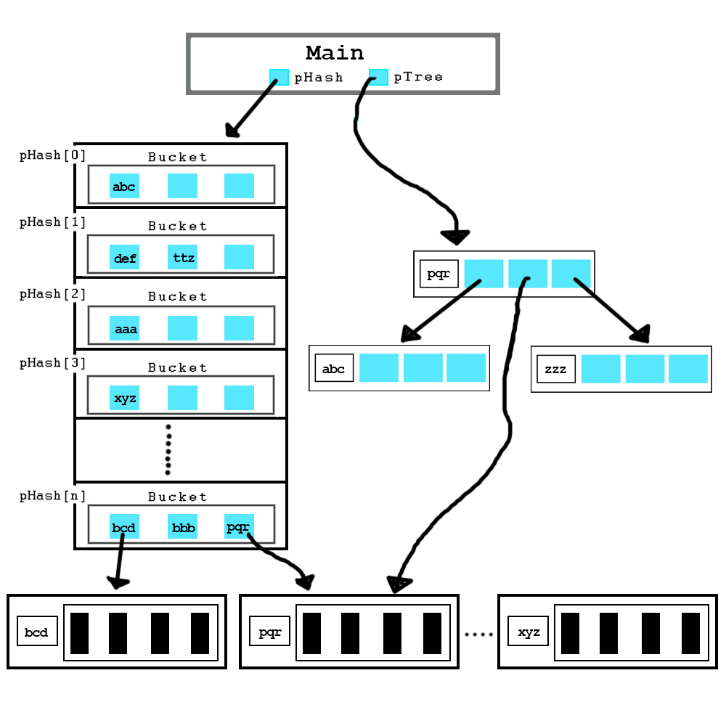
Data Structure

Slide 4
Main Hierarchy
main
readData
storeHashArray (primary key and address)
storeBST (hash key and address)
readFromFile
storeDataDynamicMem
resolveCollisions
Menu (Hash)
AddData
DeleteData
FindDisplayData
displayFoundData
ListDataHash(hash table sequence)
ListDataKey (key sequence)
PrintIndentTree
WriteToFile
DisplayEfficiency
Quit
BucketHashing
Key Sequence (Alphabetically)
displayLoadFactor
displayLongestBucket
displayNumCollisions
Breadth-First Traversal (Queue)

Slide 5
Team Member Coding Breakdown
Main.cpp
SystemOutput.h
FileIO.h
HashTable.h & HashBucket.h
BinarySearchTree.h
Derek Chan
Derek Chan
Arjan Sohal
Matt Byers
Derek Chan

Slide 6
Hash Function
int HashString(const string & key)
{
unsigned int k, retVal = 0;
//creats keys only off first 5 chars
for (k = 0; k < key.length() && k < 5; k++)
retVal = 37 * retVal + key[k];
return retVal;
}

Slide 7
Collision Resolution Method
Bucket is a structure that accommodates multiple data occurrences (Bucket Hashing)
Bucket Size = 3
Cannot insert into a full bucket, error message will be printed

